Slide 1
SharePoint 2010 Best Practices

Slide 2
Agenda
Code Access Security
Design Considerations
Unit Testing
Environments
Deployment

Slide 3
Code Access Security
Design for the Sandbox by default
Basic Features (Events, Actions)
Basic Web Parts
Workflow
Use custom CAS policies outside the Sandbox
Advanced Web Parts (Business Data, FullTextQuery)
Office Add-Ins
Deploy to the GAC only when necessary
LAYOUTS pages inheriting LayoutsPageBase
Information Policies
Use appropriate approaches in other cases
Excel Services UDF

Slide 4
Supported Sandbox Solutions
Content Types, Site Columns
Custom Actions
Declarative Workflows
Event Receivers, Feature Receivers
InfoPath Forms Services (not admin-appr) JavaScript, AJAX, jQuery, Silverlight
List Definitions
Non-visual web parts
Site Pages
SharePoint OnLine
Notes:
The message her is that a wide-variety of solutions are supported

Slide 5
Custom CAS Policies
<CodeAccessSecurity>
<PolicyItem>
<PermissionSet class="NamedPermissionSet" version="1“ Description=“Permissions">
<IPermission class="AspNetHostingPermission" version="1" Level="Minimal" />
IPermission class="SecurityPermission" version="1“
Flags="Execution,ControlPrincipal,ControlAppDomain,ControlDomainPolicy,ControlEvidence" />
<IPermission class="Microsoft.SharePoint.Security.SharePointPermission,
Microsoft.SharePoint.Security, Version=12.0.0.0, Culture=neutral,
PublicKeyToken=71e9bce111e9429c" version="1" ObjectModel="True" Impersonate="True“
UnsafeSaveOnGet="True"/>
<IPermission class="System.Security.Permissions.SecurityPermission, mscorlib,
Version=2.0.0.0, Culture=neutral, PublicKeyToken=b77a5c561934e089" version="1“
Flags="ControlThread, UnmanagedCode" />
<IPermission class="System.Security.Permissions.EnvironmentPermission, mscorlib,
Version=2.0.0.0, Culture=neutral, PublicKeyToken=b77a5c561934e089" version="1“
Read="UserName" />
</PermissionSet>
<Assemblies>
<Assembly Name=“MyAssembly"/>
</Assemblies>
</PolicyItem>
</CodeAccessSecurity>

Slide 6
Custom CAS Policies
demo
Notes:
This is a simple demo designed to show deployment in different ways
Make a new VS2010 project, select to deploy to the Farm
Then change the “Sandboxed Solution” property and deploy to the site collection
Then take the WSP and run a PS script to deploy it

Slide 7
Design Considerations
Identify dependencies
Package common components separately
Be easy on the portal home page
Use the Sandbox to limit resource usage
Avoid referencing the Items collection directly
Avoid excessive looping constructs
Avoid the use of custom site definitions
Utilize site templates
Utilize feature staples
Consider upgrades
Understand the effect of upgrading the feature
Anticipate the effect of upgrading to v.next

Slide 8
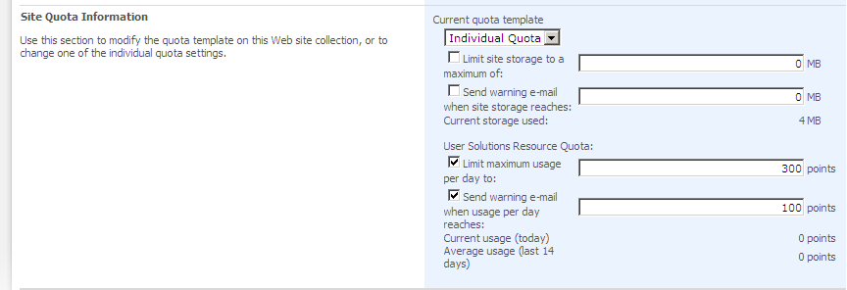
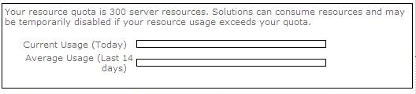
Resource Quotas
Central
Admin
Solution
Gallery
Notes:
This is a look at the quota administration page in Central Admin

Slide 9
Feature Stapling
<?xml version="1.0" encoding="utf-8" ?>
<Elements xmlns="http://schemas.microsoft.com/sharepoint/">
<FeatureSiteTemplateAssociation
Id="B8DED45F-E2D9-4a5f-BD7F-502B737BE901"
TemplateName="STS#0" />
<FeatureSiteTemplateAssociation
Id="B8DED45F-E2D9-4a5f-BD7F-502B737BE901"
TemplateName="STS#1" />
</Elements>

Slide 10
Unit Testing
Focus on appropriate error handling
Catch appropriate errors
Log to the Unified Logging Service
Run SPDisposeCheck on every assembly
Plan for Activation/Deactivation
Evaluate multiple activation/deactivation cycles

Slide 11
SPDisposeCheck
void CreatingSPSiteLeak() {
SPSite siteCollection = new SPSite("http://moss");
}
void CreatingSPSiteExplicitDisposeNoLeak() {
SPSite siteCollection = null;
try {
siteCollection = new SPSite("http://moss");
}
finally {
if(siteCollection != null)
siteCollection.Dispose();
}
}
void CreatingSPSiteWithAutomaticDisposeNoLeak(){
using (SPSite siteCollection = new SPSite("http://moss")) {
// your OM code here
} // SPSite object siteCollection.Dispose() automatically called
}

Slide 12
Memory Leaks
demo
Notes:
This is a simple demo designed to show deployment in different ways
Make a new VS2010 project, select to deploy to the Farm
Then change the “Sandboxed Solution” property and deploy to the site collection
Then take the WSP and run a PS script to deploy it

Slide 13
Dev > QA > Production
Provide each developer with a separate development environment
Utilize Solution Files (WSP) for all SharePoint solutions
Avoid direct changes to the content database
Maintain code in TFS repository
Compile in Release mode
Debug can cause server “stops”
Create a QA environment that mimics Production
Avoid “back-copying” Production database to QA
Fully test in QA environment before deploying to Production

Slide 14
Deployment
Always use Solution Files
Provide PowerShell script and WSP files
Plan for dependencies
Deploy core packages first
Avoid manual changes to web.config

Slide 15
Solution Deployment
demo
Notes:
This is a simple demo designed to show deployment in different ways
Make a new VS2010 project, select to deploy to the Farm
Then change the “Sandboxed Solution” property and deploy to the site collection
Then take the WSP and run a PS script to deploy it

Slide 16
Summary
Code Access Security
Design Considerations
Unit Testing
Environments
Deployment

